Slide 1
Google Cloud Platform 2022
jges113

Slide 2
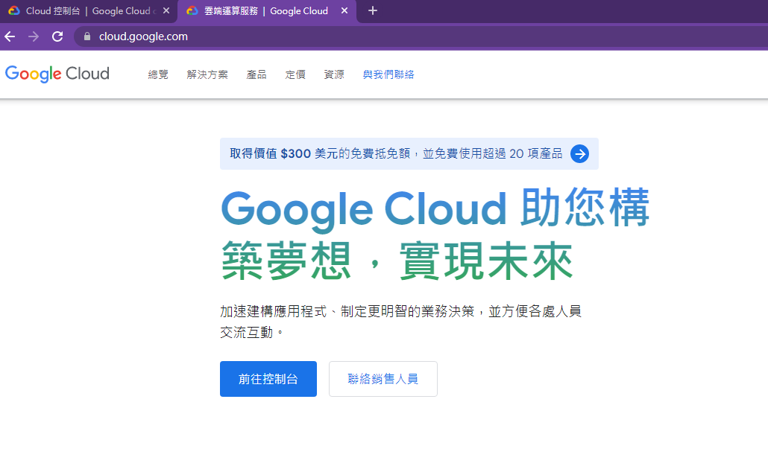
Google Cloud Platform (GCP)
https://cloud.google.com/

Slide 3
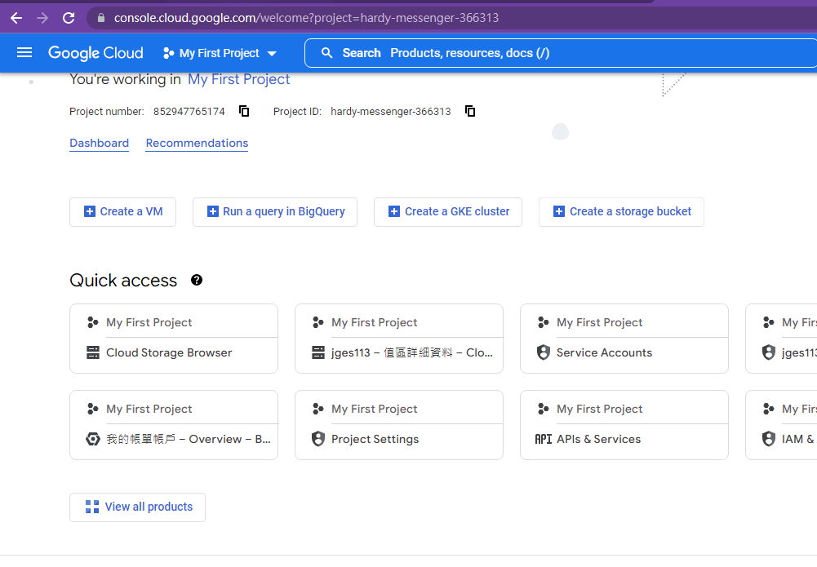
Google Cloud Console
https://console.cloud.google.com/

Slide 4
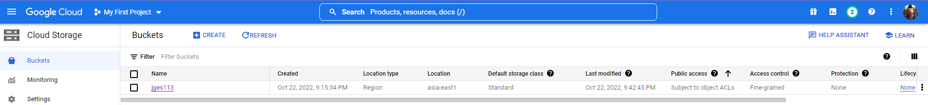
Cloud Storage
Buckets
Objects
Create jges113 with the following parameters

Slide 5
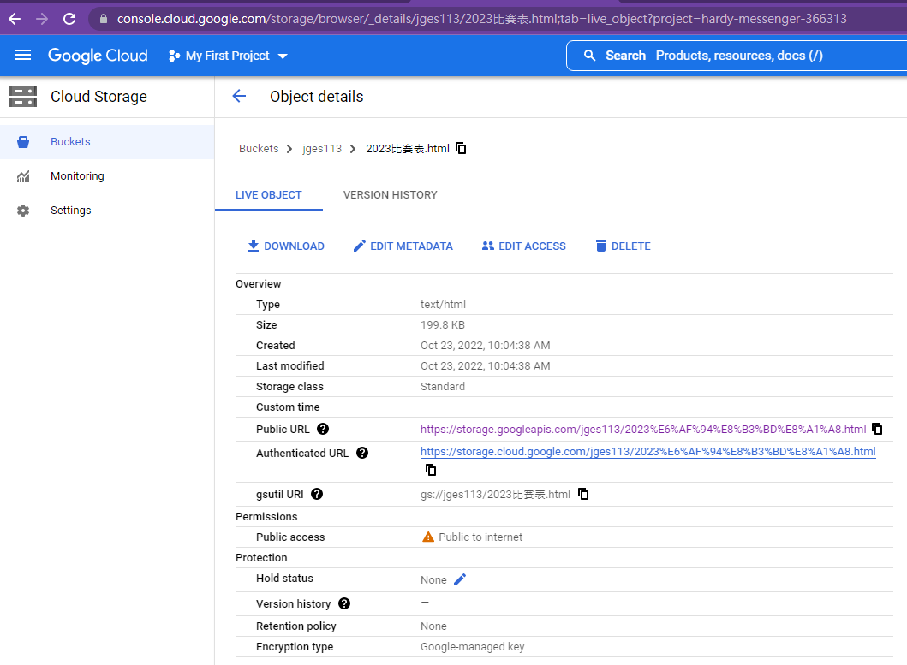
Cloud Storage
Buckets
Object details
Public URL
https://storage.googleapis.com/jges113/2023%E6%AF%94%E8%B3%BD%E8%A1%A8.html
Gsutil URI
gs://jges113/2023比賽表.html

Slide 6
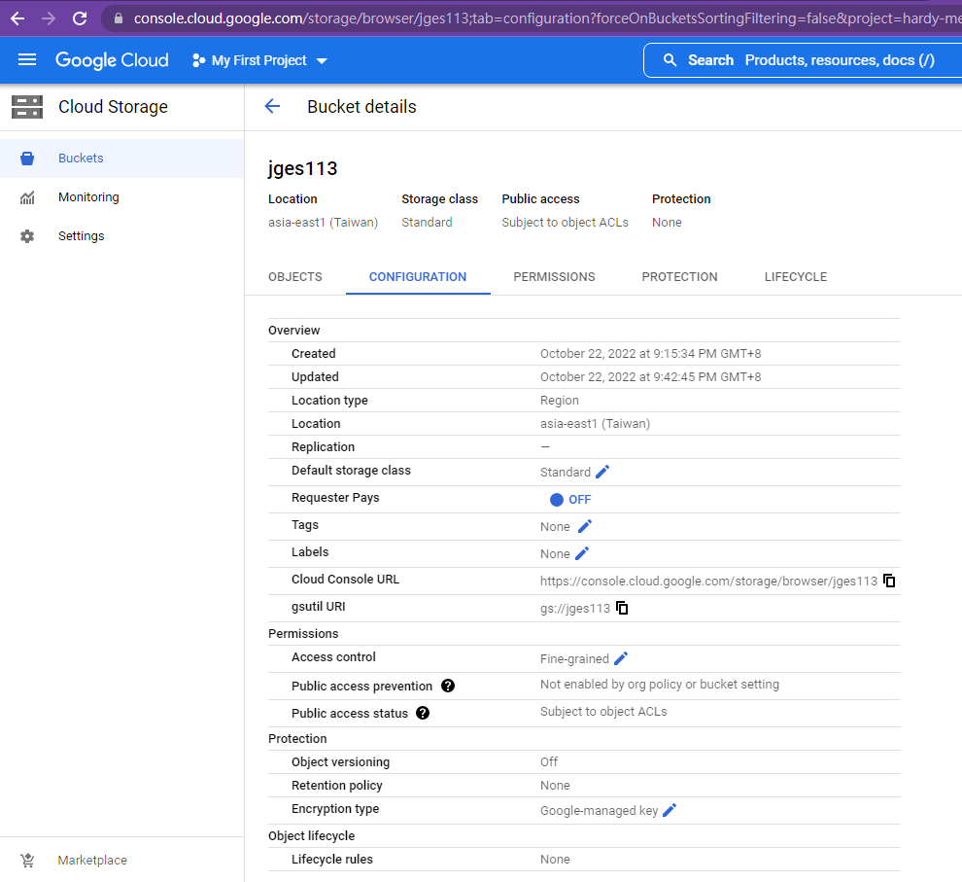
Cloud Storage
Buckets
Configuration
Cloud Console URL
https://console.cloud.google.com/storage/browser/jges113
gsutil URI
gs://jges113

Slide 7
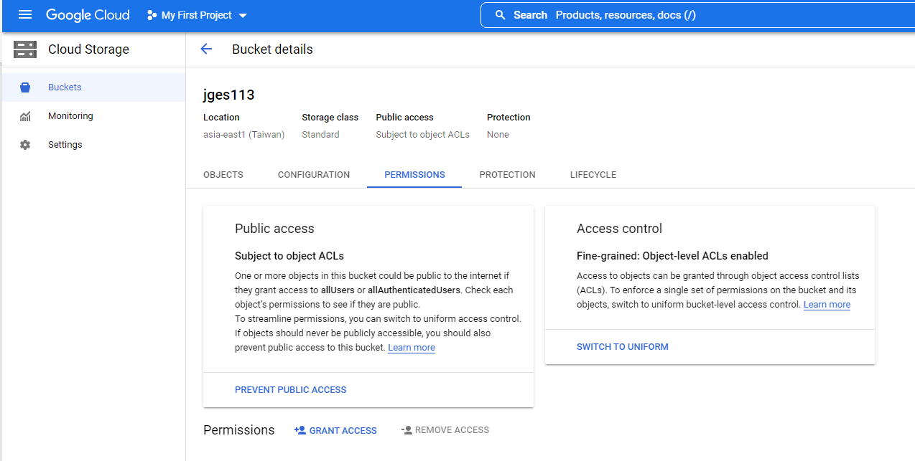
Cloud Storage
Buckets
Permissions

Slide 8
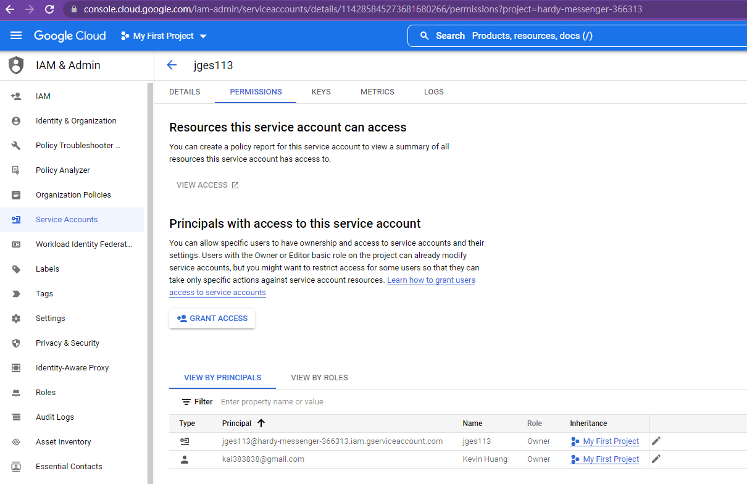
IAM & Admin
Service Account
Permissions

Slide 9
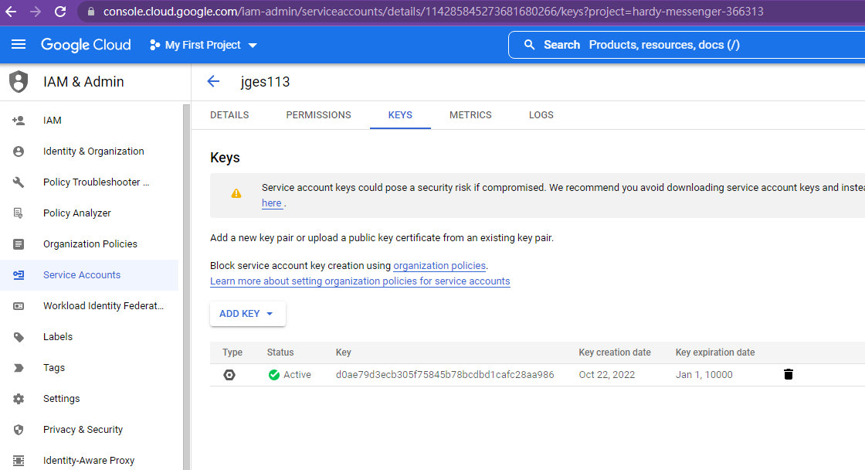
IAM & Admin
Service Account
Keys
Generate your key (.json file)

